Slide 1
Mobile Application Development
David Drohan (ddrohan@wit.ie)

Slide 2
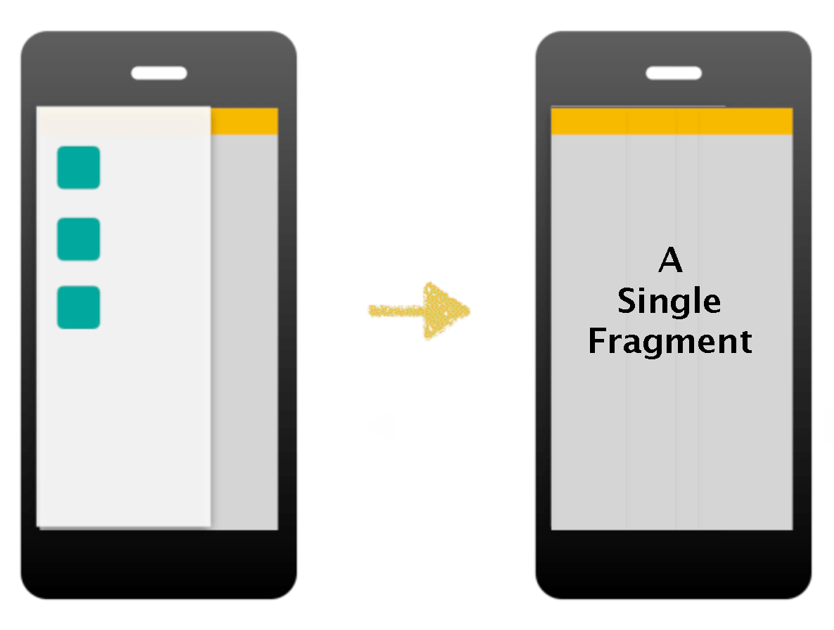
Donation Code Walkthrough

Slide 3
Agenda
Manual Nav Drawer Setup Walkthrough
Code Extracts from Donation

Slide 4

Nav Drawer in Donation
Manual Setup (no Navigation Component)

Slide 5
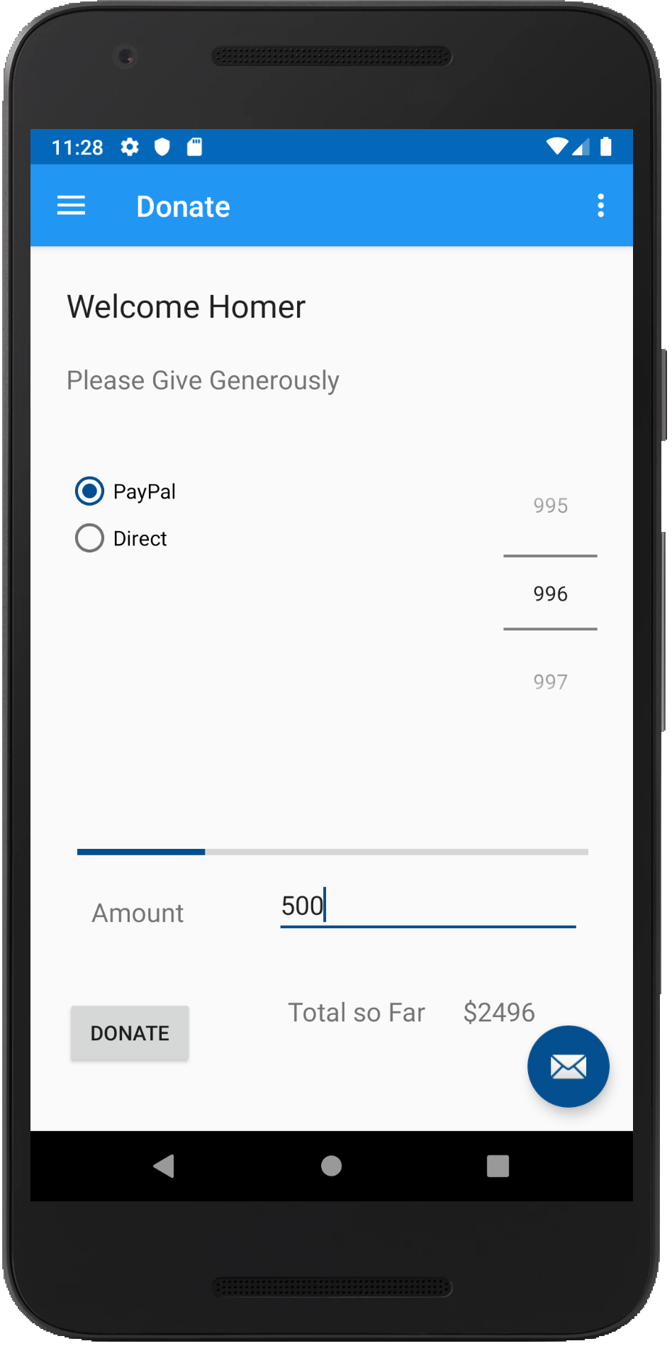
Case Study
An Android App to keep track of donations made to ‘Homers Presidential Campaign ’.
App Features
Accept donation via number picker or typed amount
Keep a running total of donations
Display report on donation amounts and types
Display running total on progress bar

Slide 6
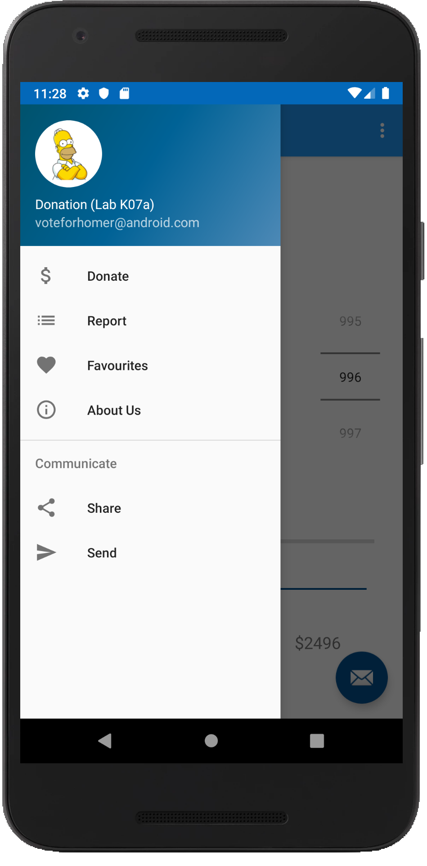
Case Study
An Android App to keep track of donations made to ‘Homers Presidential Campaign ’.
App Features
Accept donation via number picker or typed amount
Keep a running total of donations
Display report on donation amounts and types
Display running total on progress bar

Slide 7
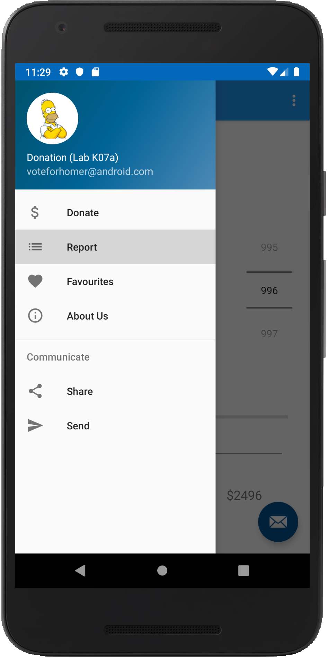
Case Study
An Android App to keep track of donations made to ‘Homers Presidential Campaign ’.
App Features
Accept donation via number picker or typed amount
Keep a running total of donations
Display report on donation amounts and types
Display running total on progress bar

Slide 8
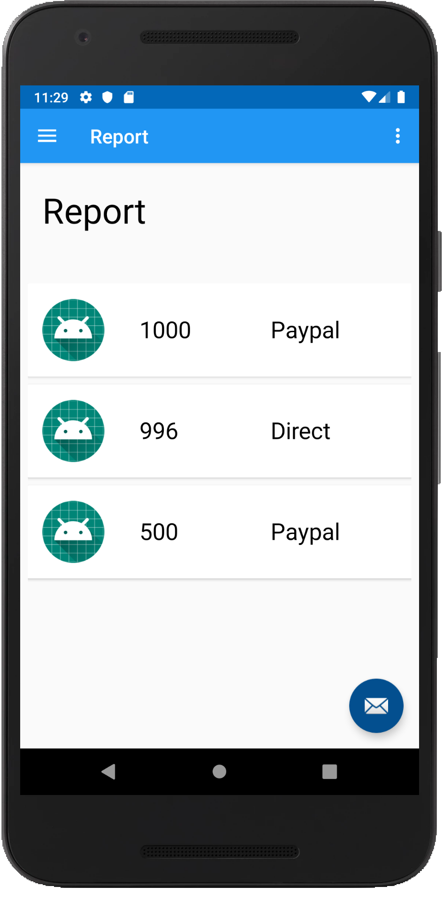
Case Study
An Android App to keep track of donations made to ‘Homers Presidential Campaign ’.
App Features
Accept donation via number picker or typed amount
Keep a running total of donations
Display report on donation amounts and types
Display running total on progress bar

Slide 9
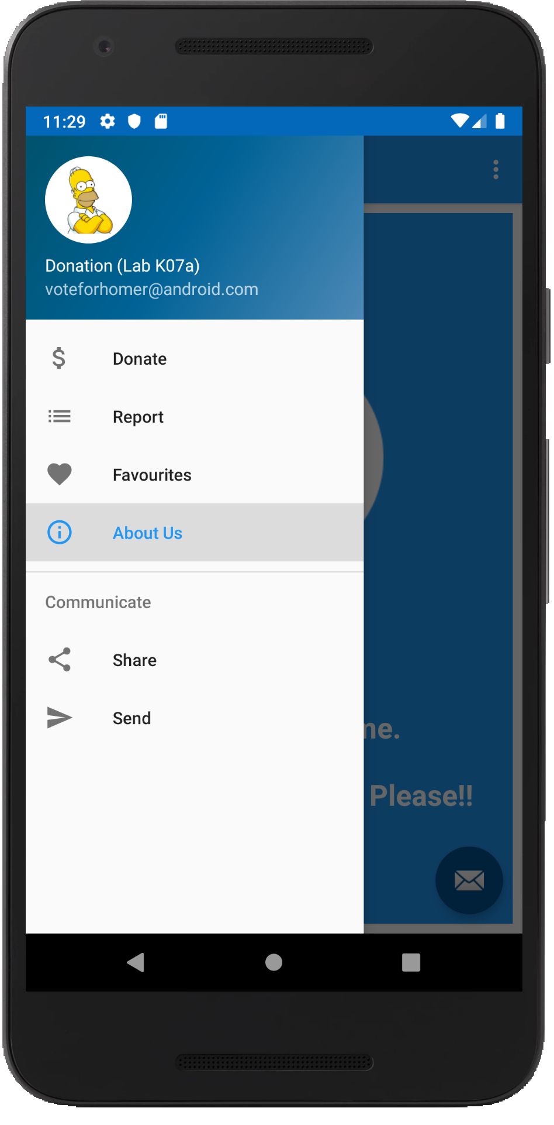
Case Study
An Android App to keep track of donations made to ‘Homers Presidential Campaign ’.
App Features
Accept donation via number picker or typed amount
Keep a running total of donations
Display report on donation amounts and types
Display running total on progress bar

Slide 10
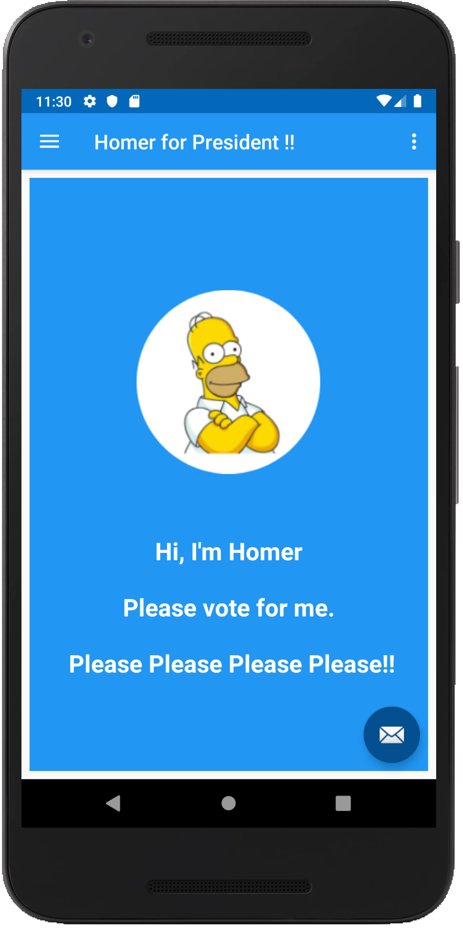
Case Study
An Android App to keep track of donations made to ‘Homers Presidential Campaign ’.
App Features
Accept donation via number picker or typed amount
Keep a running total of donations
Display report on donation amounts and types
Display running total on progress bar

Slide 11
Navigation Drawer Overview
Android Studio (and the Navigation Library) does a lot of the heavy lifting for you, but generally the following steps are necessary to add a Navigation Drawer to your app
Create drawer layout
Bind to navigation drawer layout
Handle navigation drawer click and
Update content based on user selection

Slide 12
Overview - Create Drawer Layout
For creating a navigation drawer, first we need to declare the drawer layout in your main activity (our Home) where you want to show the navigation drawer
You add androidx.drawerlayout.widget.DrawerLayout as the root view of your activity layout.
We’ll use Donation as the example to illustrate…

Slide 13
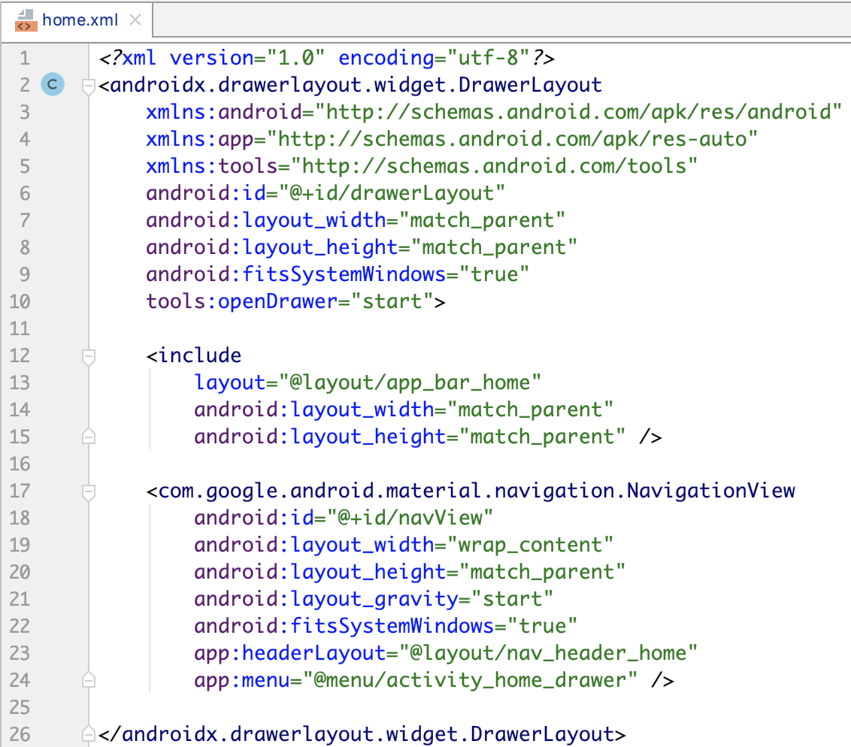
Overview - Create Drawer Layout

Slide 14
Overview - Create Drawer Layout
home.xml contains the Navigation Header (nav_header_home) AND the Navigation Drawer Menu (activity_home_drawer) inside a NavigationView.
home includes app_bar_home which will display our content
Also, note the ‘ids’ of the widgets (for later on)

Slide 15
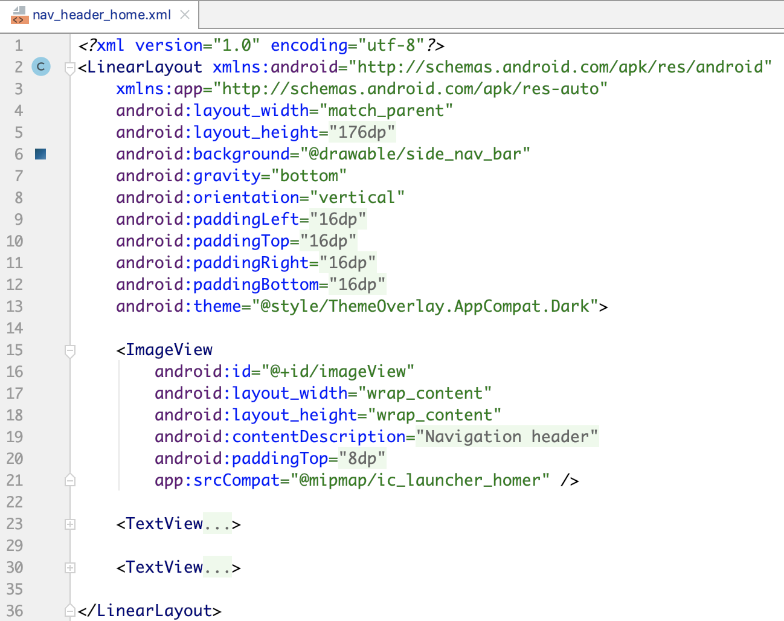
Overview – nav_header_home

Slide 16
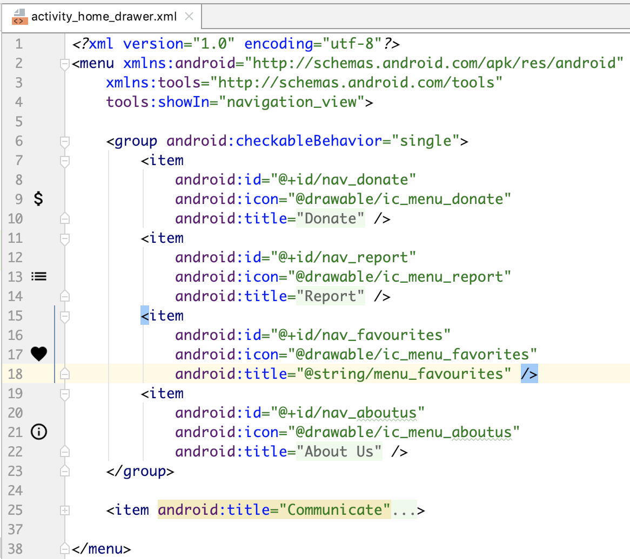
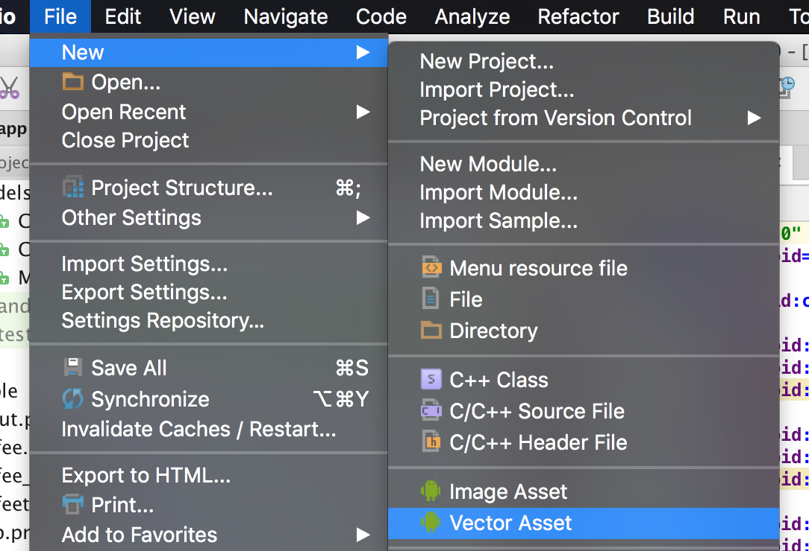
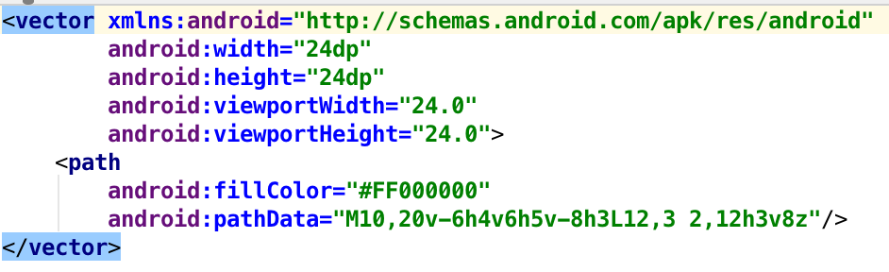
Overview – activity_home_drawer

Slide 17
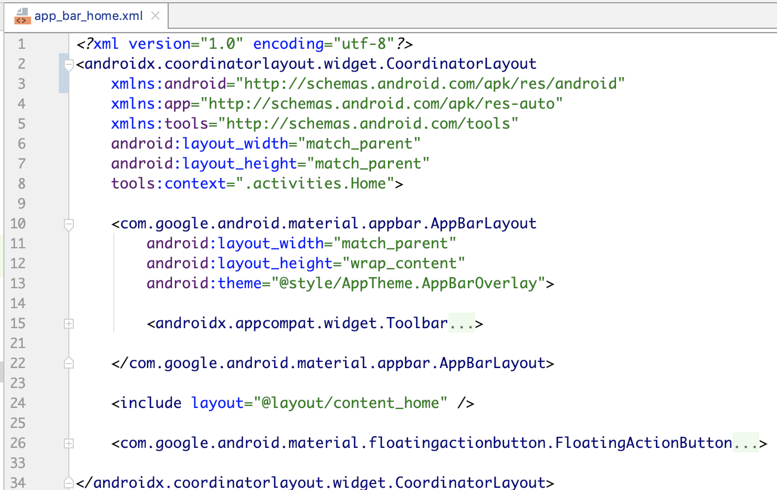
Overview – app_bar_home

Slide 18
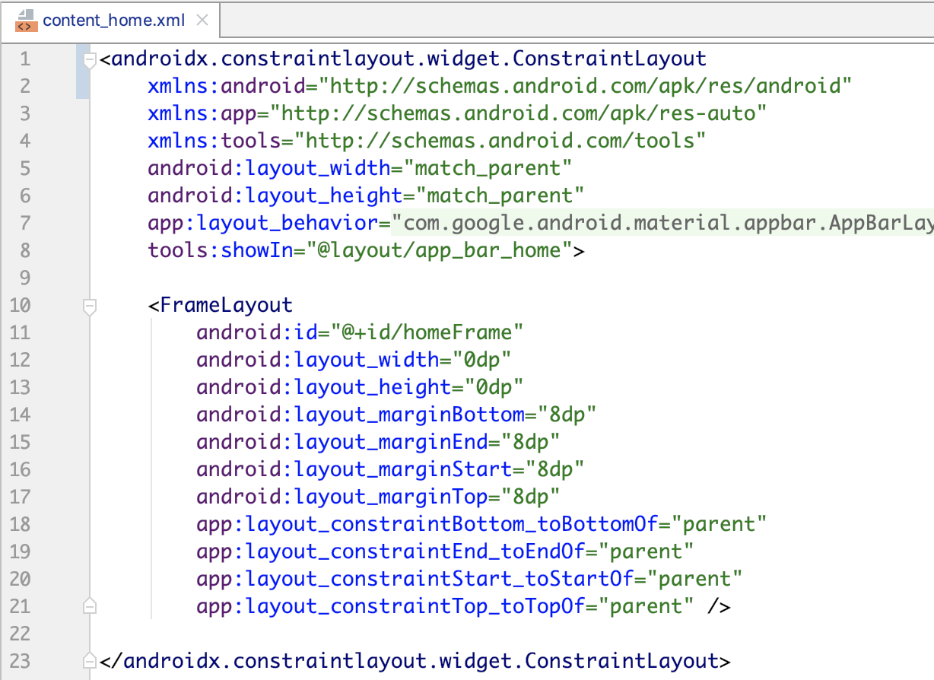
Overview – content_home

Slide 19
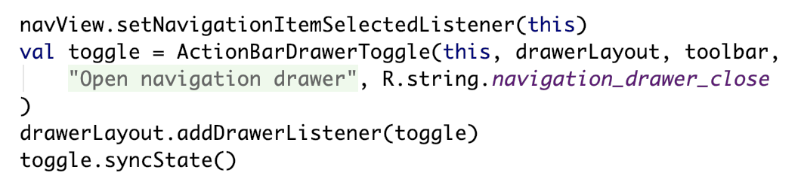
Overview – Bind to the Drawer Layout etc.
Once you have the necessary layouts and menu in place, you then need to bind to the Drawer and Navigation View to allow you to handle the user navigation and switching content based on user selection.
In your onCreate()you’ll have something like the following

Slide 20
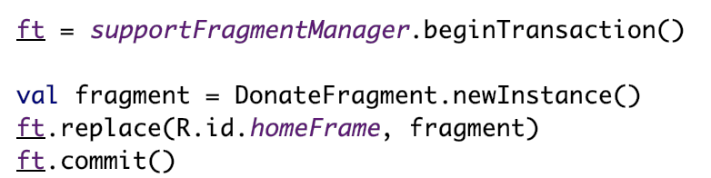
Overview – Bind to the Drawer Layout etc.
You’ll probably want to display some kind of initial landing page once the app starts so in our example, we load up the Donate Screen (maintained in our DonateFragment)
Again, in your onCreate() you’ll have something like the following
This creates a new instance of a DonateFragment and replaces the fragment in our FrameLayout with this instance

Slide 21
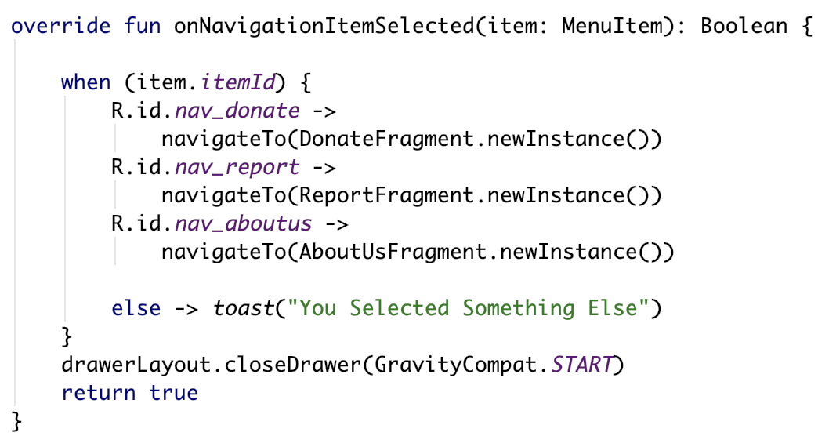
Overview – Handle Drawer Click & Update Content *
To handle users menu selection we implement the following

Slide 22
Overview – Handle Drawer Click & Update Content *
To handle users menu selection we implement the following

Slide 23
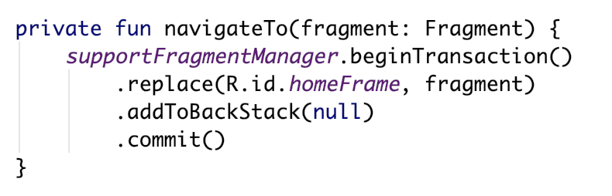
Overview – Handle Drawer Click & Update Content *
To handle users menu selection we implement the following

Slide 24
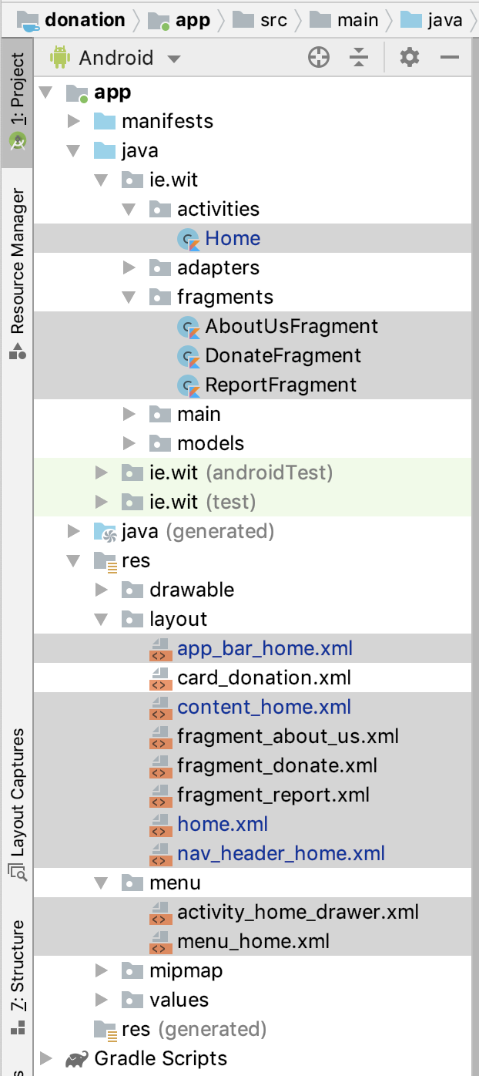
Project Structure
Added Layouts & Menus (Manually)
Added ‘Controller’ Home (Manually)
Added ‘Blank Fragments’ (Auto, but managed Manually)

Slide 25

References
Sources: https://blog.mindorks.com/android-navigation-drawer-in-kotlin
https://medium.com/@umang.burman.micro/navigation-drawer-with-navigation-component-4f032bfdeae6
https://developer.android.com/guide/navigation
https://medium.com/@myric.september/navigation-in-android-navigation-architecture-component-a1f103a6cc52
https://material.io/components/navigation-drawer/#

Slide 26


